Slide 1
Milestone 2
Team 6
Apps Linking Midshipmen and Officers

Slide 2
Project Management
Concise Project Overview
Targeted Functional Requirement
Functional Requirements Trace Table
Risk Management
Meetings
Workload Matrices
Gantt Chart

Slide 3
Concise Project Overview
The Research Grant Status Tracker (RGST) is aimed to provide a quick, reliable, and easy to use interface that can display queried work order balances to authorized users. The current process of receiving a balance inquiry on a research grant takes unnecessary time for the requester and causes extra work for Ms. Jean Schroeder, USNA’s Grant Specialist, as she must manually process every request. This process is accomplished by a sequence of copy and pastes into an all-encompassing Microsoft Excel spreadsheet by Ms. Schroeder. Using the proposed RGST System, Naval Academy staff will be able to personally query their own work orders’ and research grants’ balance and budget their projects accordingly from their accounts which will access the new database system that we will develop for Ms. Schroeder. Our team will be focused on producing the web-front for secure database access. Project specifications include fast, accurate, and confidential data transfer in an extremely navigable manner. Furthermore, we hope to ease Ms. Schroeder’s method of entering work orders by giving her administrative access to the website to which she may have read and write access to all applicable grant entries.

Slide 4
Targeted Functional Requirement
Functional Requirement | Acceptance Test Plan | Build
Informational and useful log files | 9.1 - Throughout admin’s interactions with site their actions are securely logged (normal) 9.2 - When the admin continuously resubmits a form identical messages are not generated (abnormal) | Build 3

Slide 5
Risk Management
Priority | Risk | Risk Management Technique | Status
Probability: Medium Severity: High | Permanently deleting someones information by mistake | Create very detailed and dated log files so that if something is ever deleted it would take a simple copy and paste command to restore the data back to the way that it was. | Preparing structured format for log files.

Slide 6
Meetings
Malek-Madani 20SEP16- Approved our binder and proposal. He recommends that we continue working with Ms. Schroeder, that we set up a meeting with Mr. Haugi in the comptroller's office, and that we eventually meet with ITSD to pursue the possibility that the work we are doing could eventually be moved over to the intranet.
LCDR Kenney 22SEP16- Approved our binder and proposal. He agreed with our decision to use MySQL and PHP to build our system. He also agrees that the majority of our workload will be in our initial build of our database, and also in making sure that our site is easy to operate.

Slide 7
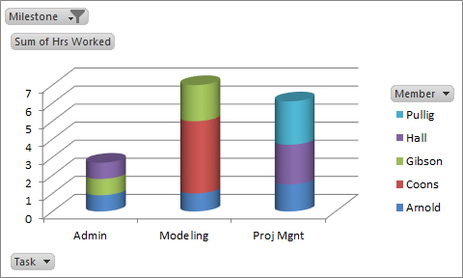
Workload Matrices

Slide 8
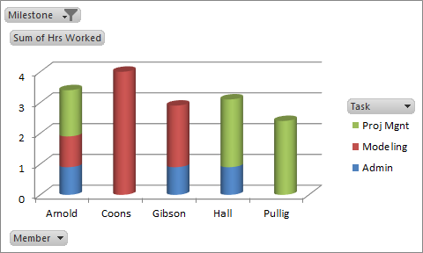
Workload Matrices

Slide 9
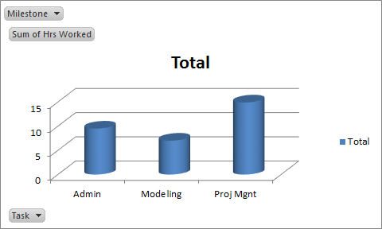
Workload Matrices

Slide 10
Workload Matrices

Slide 11
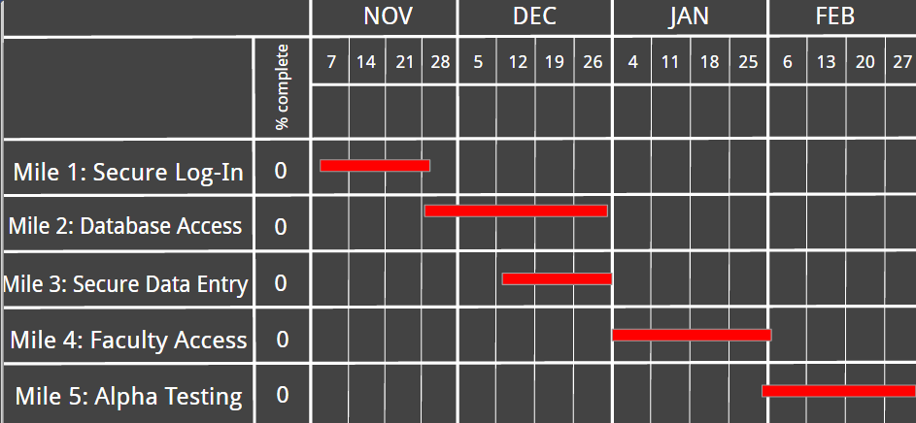
Gantt Chart

Slide 12
Modeling
Use Cases
Class Modeling
Prototyping

Slide 13
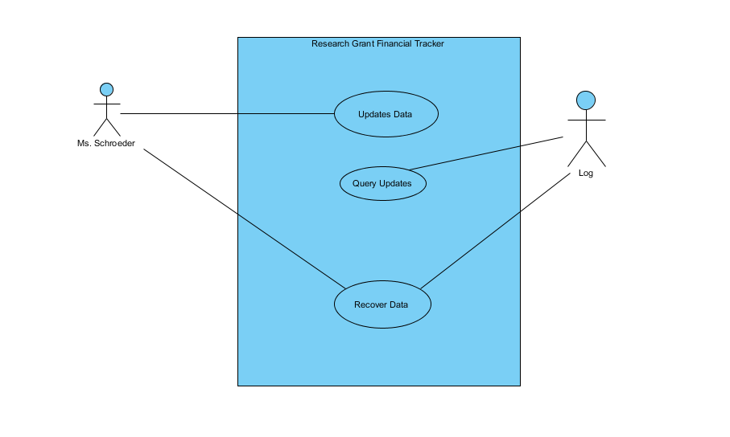
Use Case Diagram

Slide 14
UML Class Diagram Stage 1
Logging updates when admin changes values in the system with the ability to recover previous states.

Slide 15
UML Class Diagram Stage 2
The admin of our system needs to have the ability to make changes to different accounts. The administrator will log in to the system and be recognized and given permission to make changes. When changes are made, a log must be kept of the changes in the scenario that an incorrect change is made. When an incorrect change is recognized, the administrator needs to ability to query and examine changes to prevent a user’s information from being permanently deleted.

Slide 16
UML Class Diagram Stage 3
Admin
System
Account
Permission(Abstract)
Log
Scenario(Abstract)
User(Outside scope)
Information

Slide 17
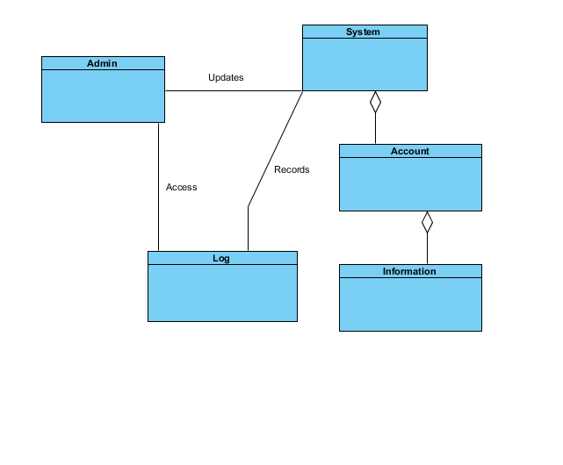
UML Class Diagram

Slide 18
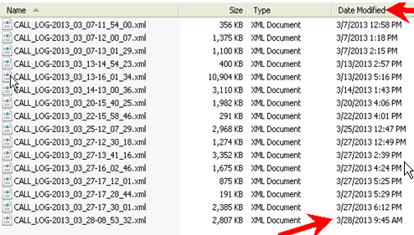
Prototype

